Slide 1
Architecture documentation (part 2)
Yauhen Baranouski
May 2023
CONFIDENTIAL | © 2023 EPAM Systems, Inc.

Slide 2
Agenda
architectural views and their purpose
“4+1” and other classical view splits
C4 views
large-scale frameworks
“views and beyond”
sample documentation templates
architecture documentation styles
CONFIDENTIAL | © 2019 EPAM Systems, Inc.

Slide 3
architectural views and their purpose

Slide 4
Architectural views and their purpose
architecture
is complex for real enterprise
has many concerns to account for
architectural view
is a representation of a subset of the system elements along with their relationships

Slide 5
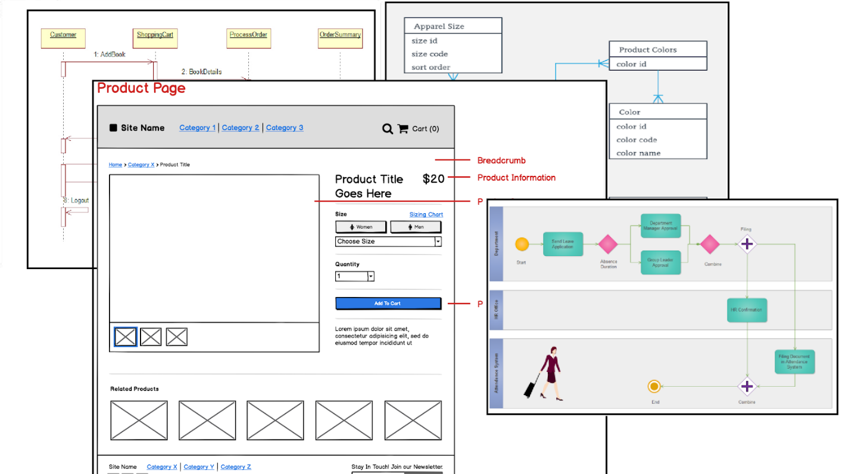
Architectural views and their purpose
architectural view (in simples words)
represents the view point of a particular stakeholder(s) on the architecture

Slide 6
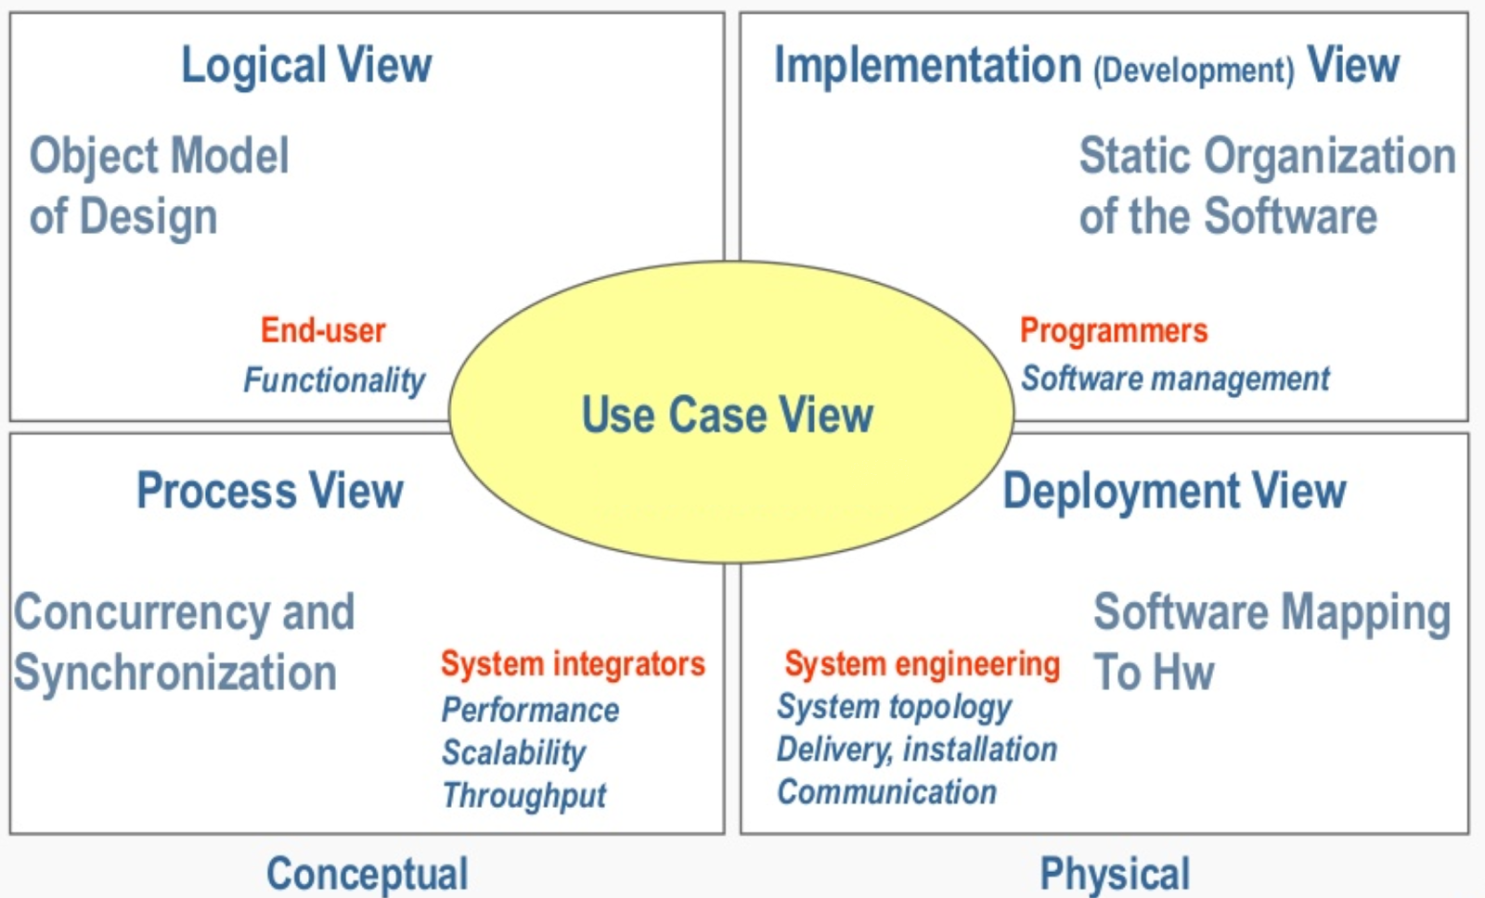
“4+1” views

Slide 7
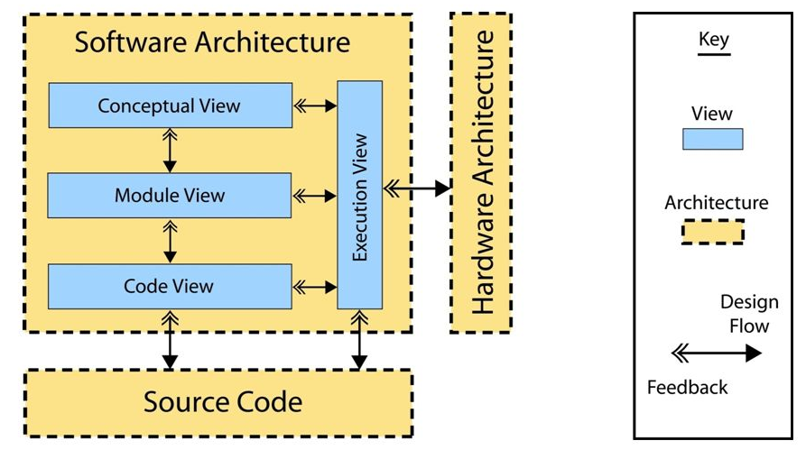
“4+1” siemens views

Slide 8
C4 views
Intuitive divide-and-conquer approach
focus on how architects and developers see software
zoom starting from the business context down to what’s important
context – the business environment (informal)
containers – the core responsibilities (informal)
components – the core tech (informal, if necessary)
code – most critical/complex details (more formal, optional)
works both for up-front design and retrospective documentation
ideal as a quick-start for documentation
more detailed diagrams like UML might be added if the high-level design is not enough for implementation or other project activities

Slide 9
C4 views
abstractions
software system – what’s modelled
person – who uses the system
containers – what hosts code and/or data (apps, scripts, DBs, etc)
components – cohesive function sets hidden behind APIs

Slide 10
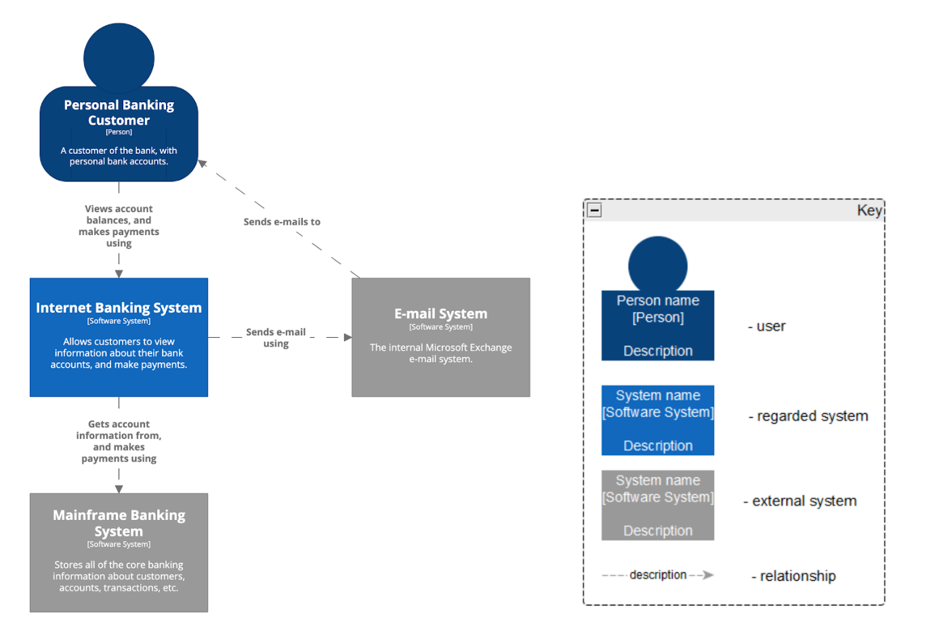
C4 views – level 1 – the system as a whole

Slide 11
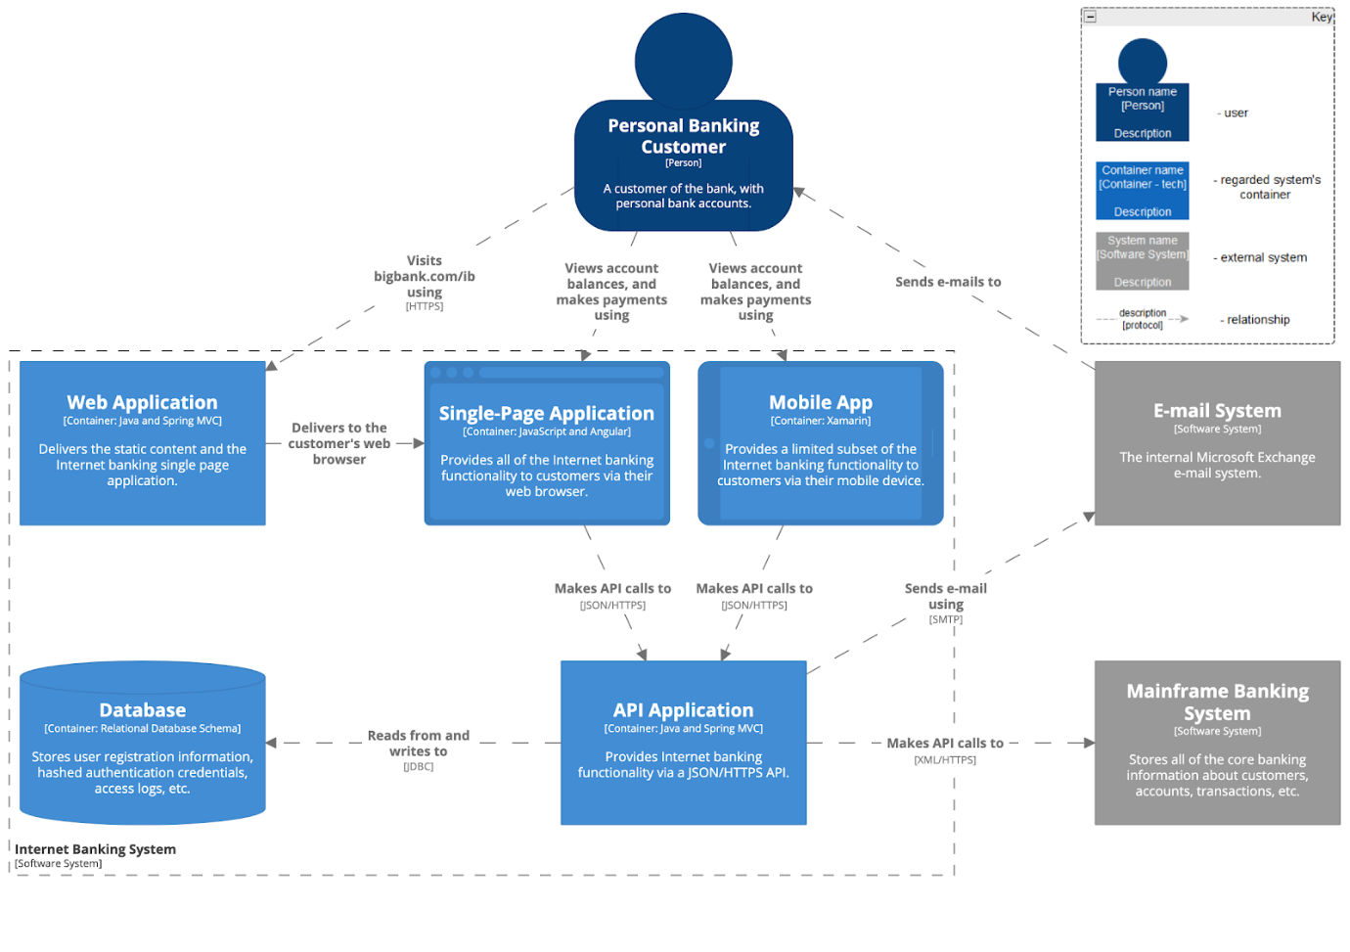
C4 views – level 2 – responsibility distribution

Slide 12
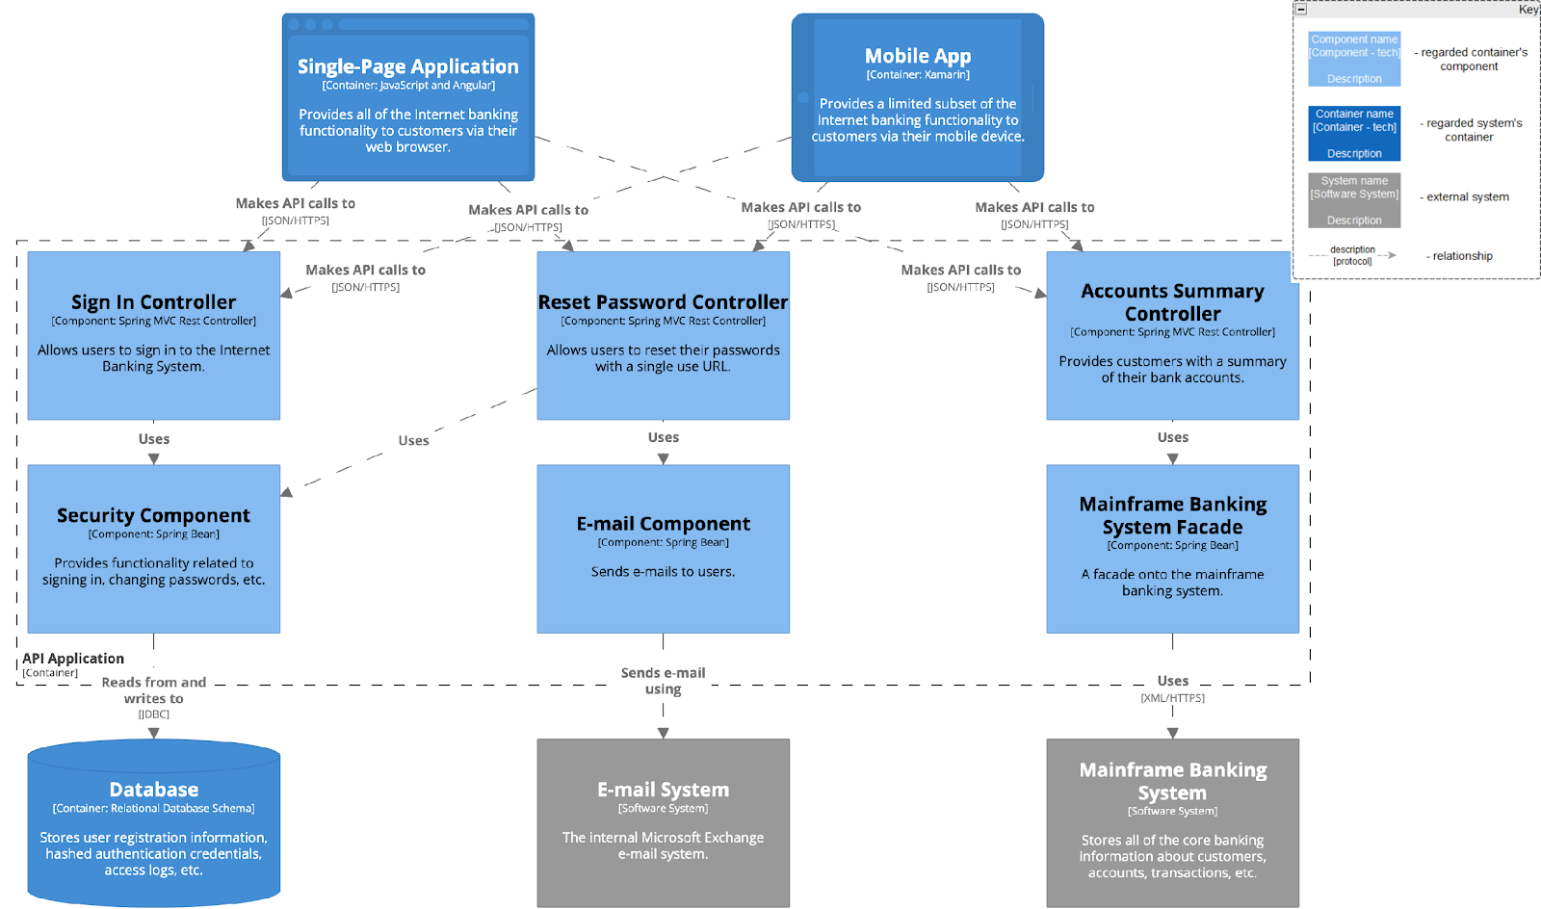
C4 views – level 3 – core tech inside the containers

Slide 13
Large scale frameworks
at a large scale
it’s hard to take everything into account and even start working
whole frameworks like Zachman and TOGAF exist
these frameworks are really bulky, but lay out a detailed action plan
these frameworks are unusable for small-medium projects

Slide 14
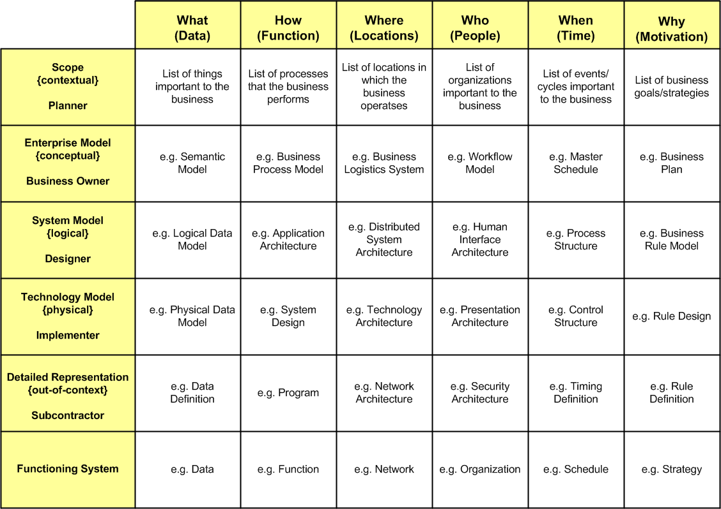
Large scale frameworks
example –zachman view priority matrix
Notes:
This is just “for your information”. Is really complex and rarely used.

Slide 15
Views and beyond
the software engineering institute (SEI) proposed to
choose custom views based on the project needs
binding these views with some context documentation – the beyond part
combine the views and beyond pages with any other docs
custom views
must fulfill the “cost < value” inequation
are chosen to fulfill the intended readers’ information needs
the more priority readers, the more details

Slide 16
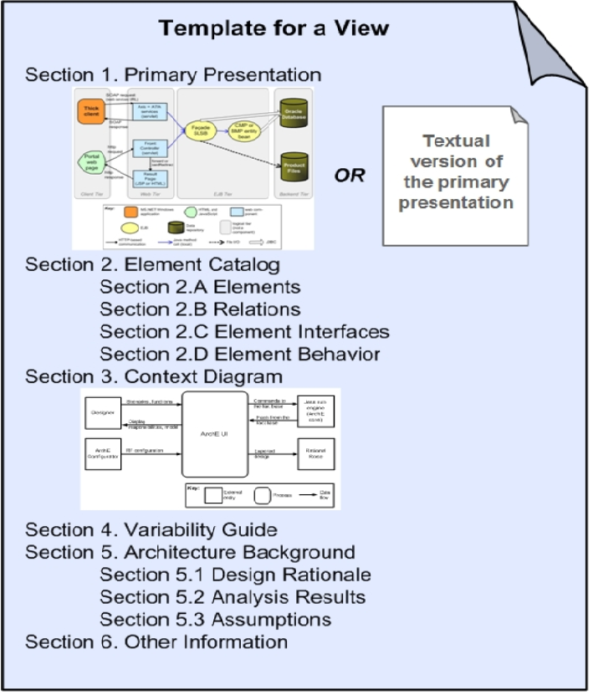
Views and beyond – view template
graphical and/or textual depiction of important elements and their relationships

Slide 17
Views and beyond – view template
glossary, notation reference, and other explanations

Slide 18
Views and beyond – view template
shows the view’s place in the overall context
is not necessarily a diagram – rather a context map therefore

Slide 19
Views and beyond – view template
possibilities for configuration, plugins, evolution

Slide 20
Views and beyond – view template
the decision path led to the current solution

Slide 21
Views and beyond – view template
something like FAQs, or history log, or any other misc information

Slide 22
Views and beyond – view template
do we need all this and only this?
all the sections are optional and may be re-ordered
just focus on making sense and linking related docs together so that they don’t get lost
multiple views may be mixed in one doc
on the other extreme, each section might be a separate doc linked in the other sections – for example, it’s reasonable to have a centralized business term glossary

Slide 23
Views and beyond – view example
Section 1 – about the document
This document describes the infrastructure required to deploy the User Service - a part of the ECommerce Platform <link to the document describing the surrounding business context and glossary>.
The other parts of the User Service solution might be found here <link>.
Key terms:
Secret Configuration store is a web service which is dedicated to storing sensible configuration properties like database passwords.
This section combines the context map and element catalog sections

Slide 24
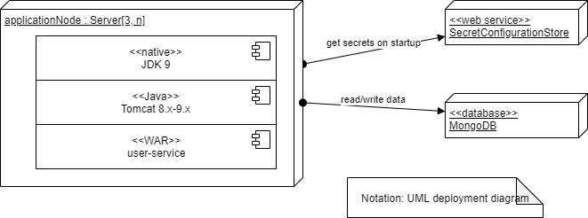
Views and beyond – view example
This is the primary representation
Section 2 - the infrastructure requirements

Slide 25
Views and beyond – view example
Also, the continuation of this section includes the architectural background
Section 2 - the infrastructure requirements
Key solutions:
Java 11 was refused in favor of Java 9 because there were memory leaks <report link> detected with the AppDynamics agents.
Functional tests <results link> run on Tomcat 8.2 and 9.0. Other Servlet containers might work (or not).
Performance tests <results link> showed that it’s necessary to have at least 3 application nodes to handle the expected load <stats link>.

Slide 26
Views and beyond – view example
This one represents the variability guide
Section 3 – deployment variations
The supported Secret Configuration Service options include:
AWS Secrets Manager - requires
the appconfig.secrets.asm.url system property
configuring an appropriate IAM role allowing the application nodes to access the above URL
HashiCorp Vault - requires
the appconfig.secrets.hcvault.url system property
configuring an appropriate IAM role allowing the application nodes to access the above URL

Slide 27
Views and beyond – view example
Section 4 – FAQ
Q: What Tomcat version do we need? (21/09/2018)
A: We successfully tested the application using Tomcat 8.2 and 9.0. Updated the diagram with that detail. (21/09/2018)
This represents the other information section

Slide 28
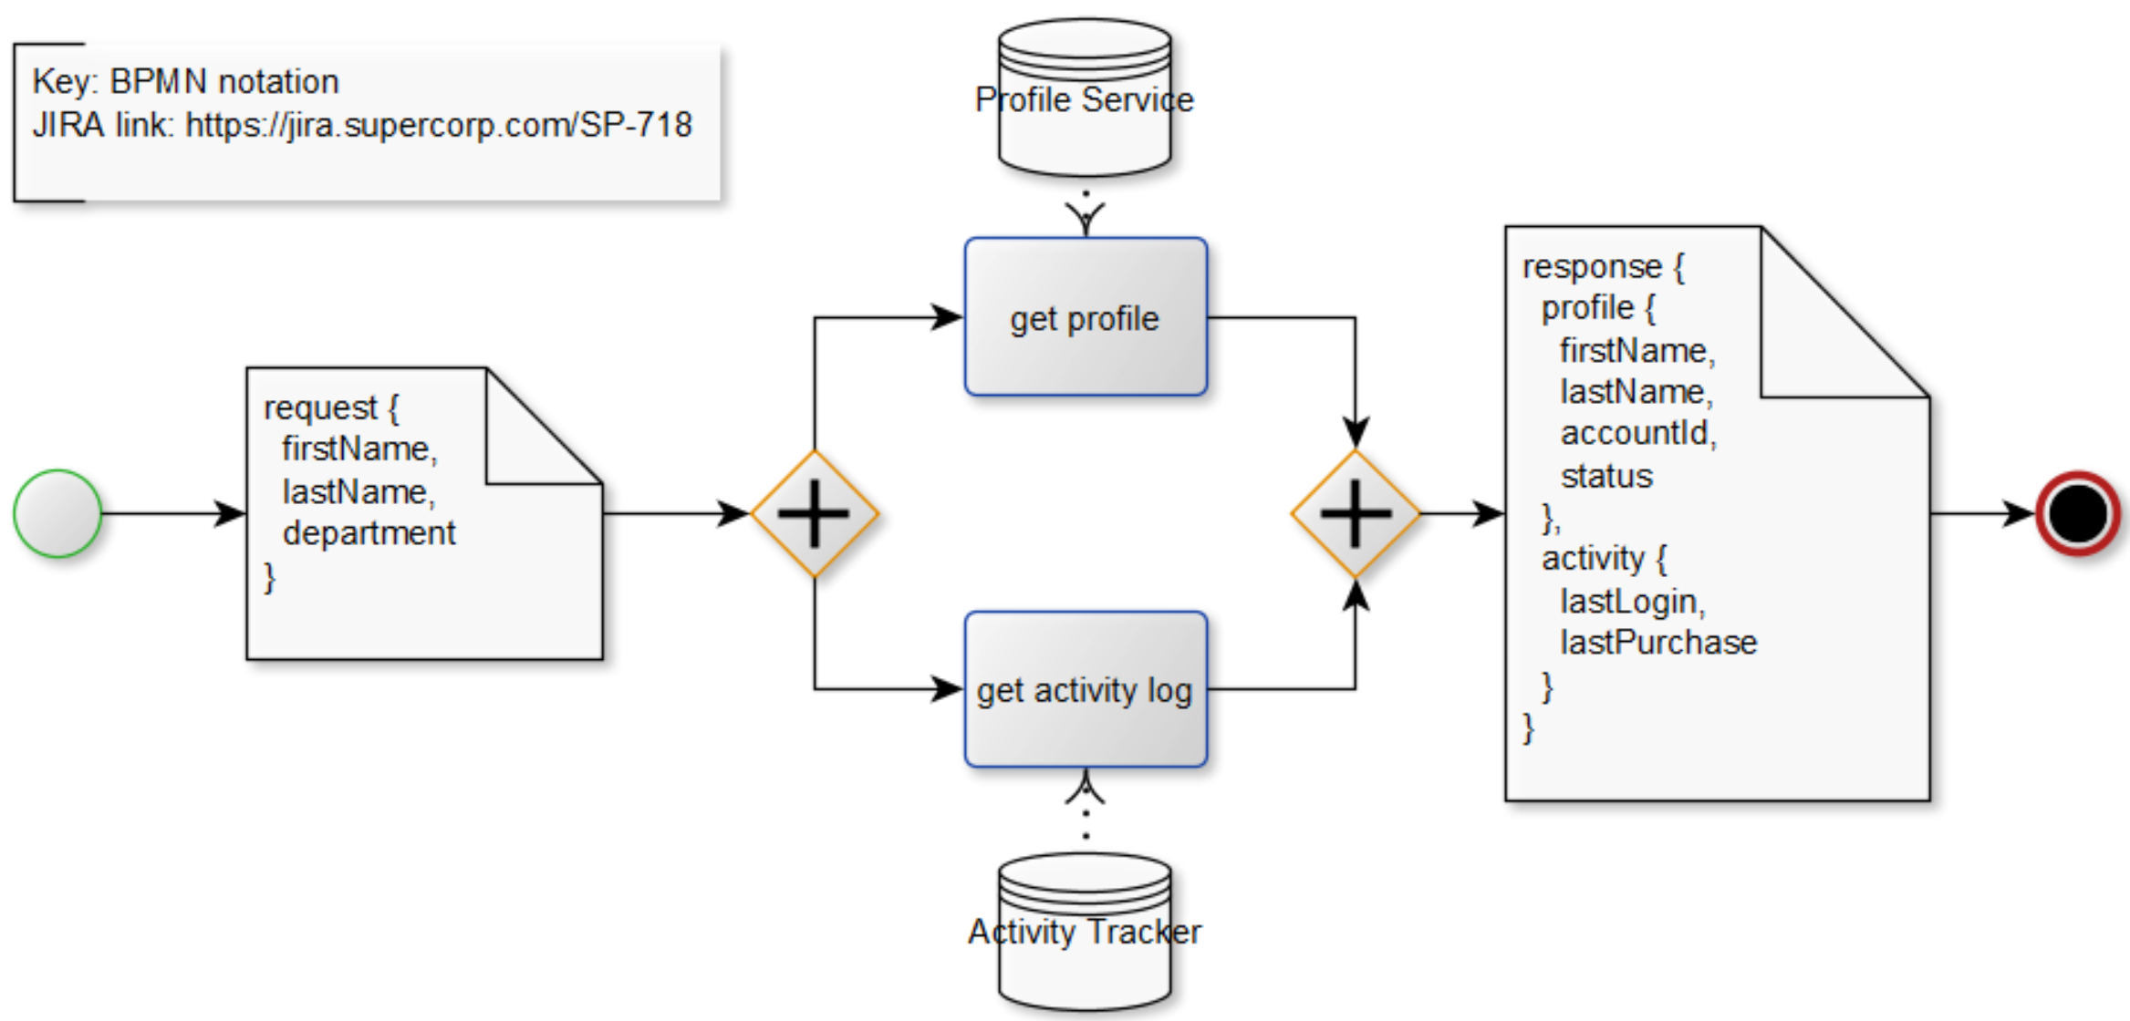
Views and beyond – multi-view example
whiteboard design =logic + model samples

Slide 29
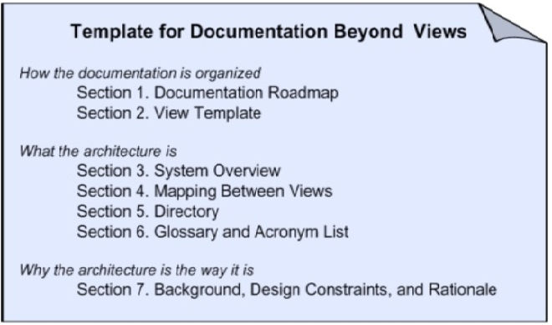
Views and beyond – “beyond” template
The “beyond” document
serves as a navigator between all the views
describes how the views are related
captures the rationale/constraints behind the architecture as a whole
Mix-n-match
“views and beyond” may be mixed with any other documentation approaches

Slide 30
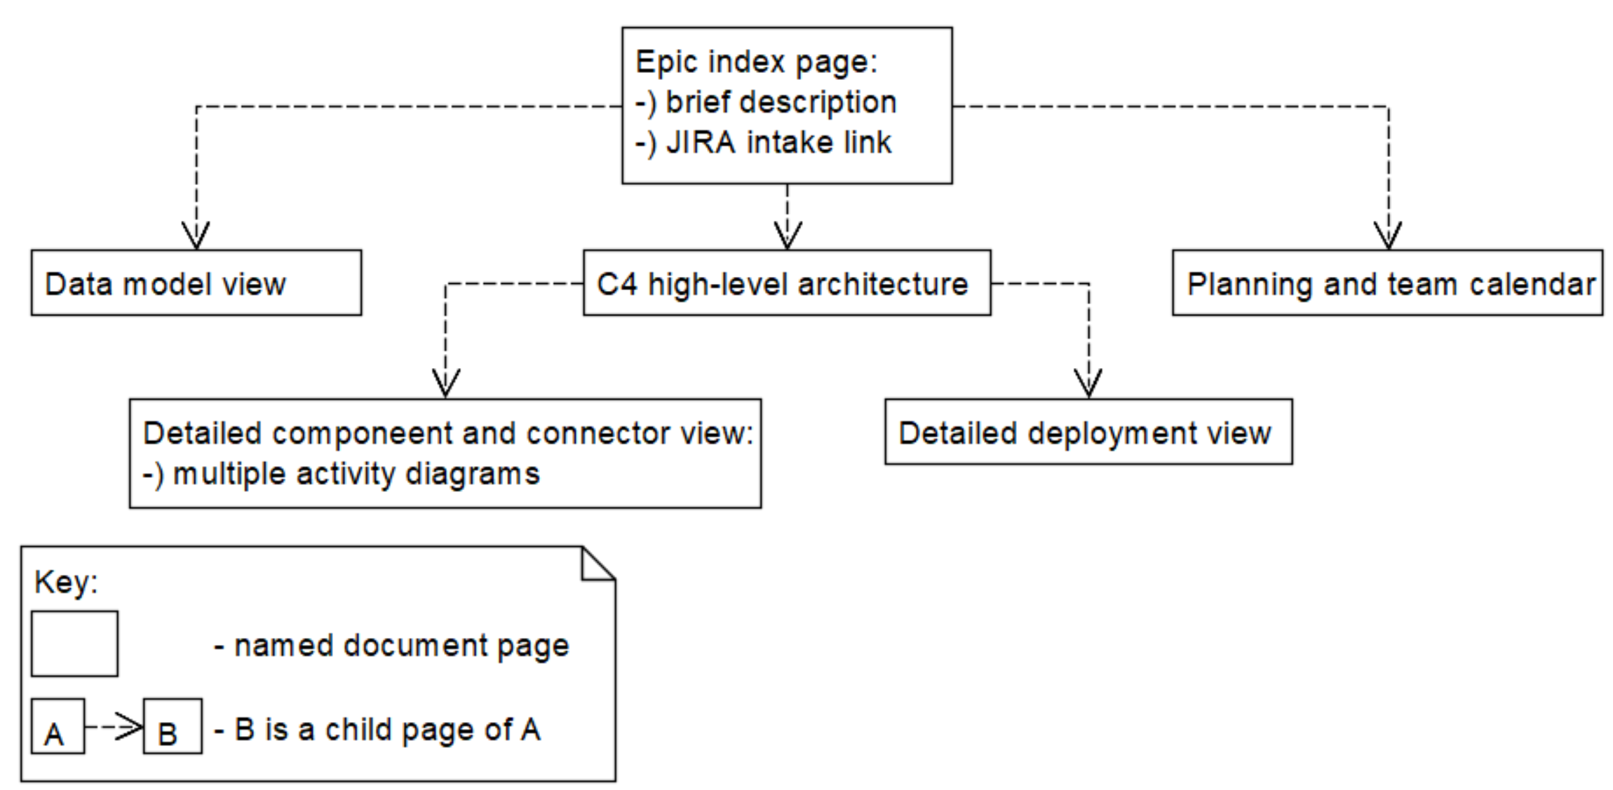
Views and beyond – doc composition example
large epics = child-parent page hierarchies

Slide 31
architecture documentation styles

Slide 32
Architecture doc styles
architecture documentation styles
are “design patterns/styles” for documentation
produce views when applied to an architectural context
are related to architectural styles/patterns
In other words, they…
limit what may be represented in a view
give a list of questions to be answered by a view

Slide 33
Architecture doc styles
major style categories
modules styles – split the system into implementation units
component-n-connector styles – show components that have behaviour and interact with each other
allocation styles – map software to non-software resources

Slide 34
Architecture doc styles – modules styles
module
is an implementation unit providing some coherent functionality
may be designed separately
may be implemented and deployed by a separate team

Slide 35
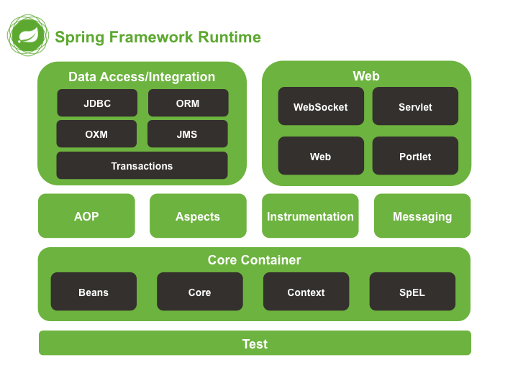
Architecture doc styles – modules styles
decomposition style
is a supertype for all modules styles
partitions the system into a module tree
where each module
is simple to reason about
may be prioritized
may be replaced by a 3rd party solution
may isolate certain functions to easier achieve certain quality attributes

Slide 36
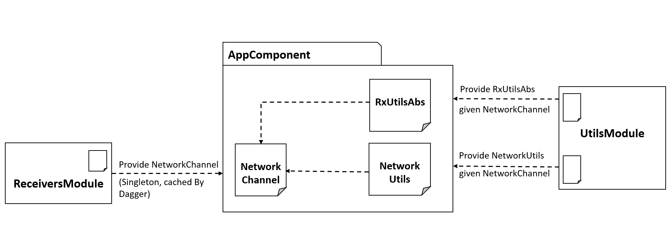
Architecture doc styles – modules styles
“uses” style
decompose focusing on dependency graph so that
development may be planned incrementally
testing and debugging is simplified
unstable/reusable code is isolated

Slide 37
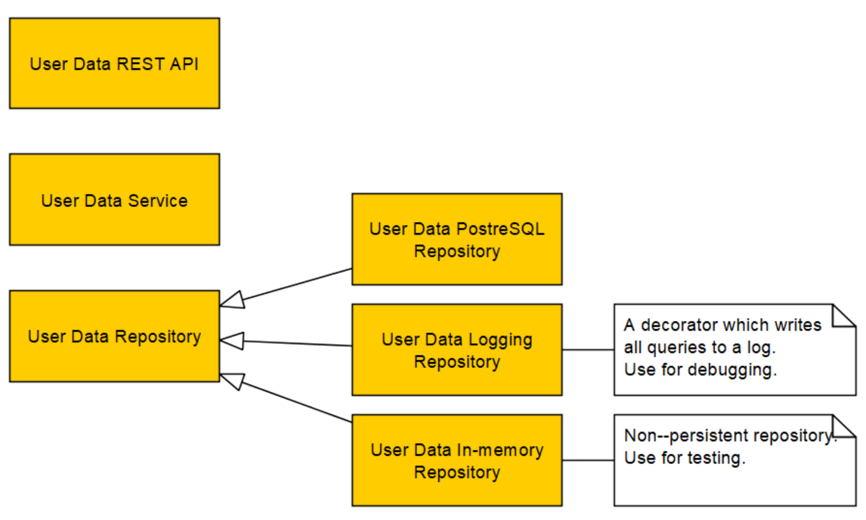
Architecture doc styles – modules styles
generalization style
decompose focusing on inheritance between modules so that
it’s easy to reuse/replace modules with the same interface
it’s easy to support variability in child modules

Slide 38
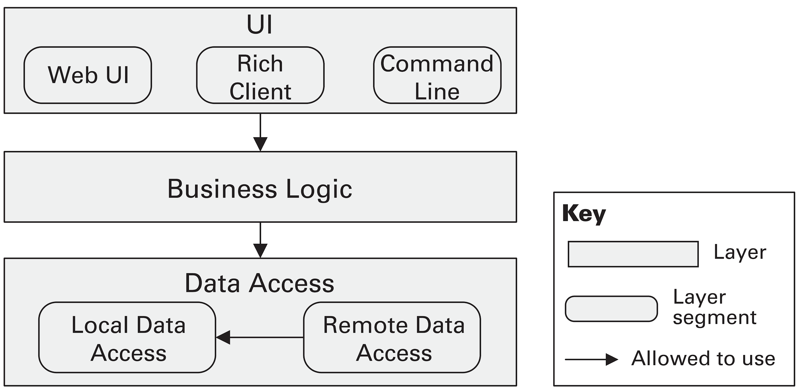
Architecture doc styles – modules styles
layered style
decompose focusing on restricting module dependencies so that
the system evolution is more predictable
portability and modifiability is achievable

Slide 39
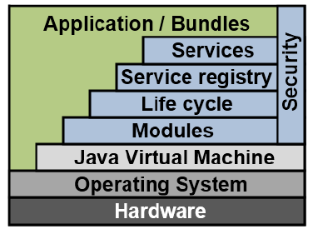
Architecture doc styles – modules styles
aspects style
decompose focusing on extracting cross-cutting concerns so that
it’s easier to modify the system
business logic is not tangled with such features as logging or security

Slide 40
Architecture doc styles – modules styles
data model style
decompose the data from the business domain
may formalize the data to facilitate automation
tries to build a common dictionary for the other views

Slide 41
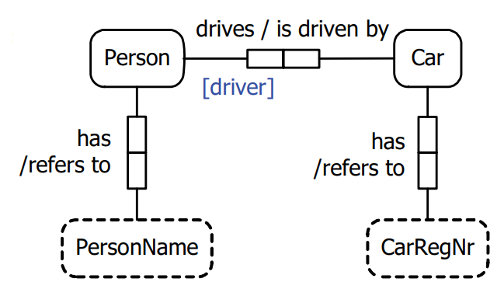
Architecture doc styles – modules styles
data model levels
conceptual
build natural and non-redundant DSL
decompose the business domain into manageable entities

Slide 42
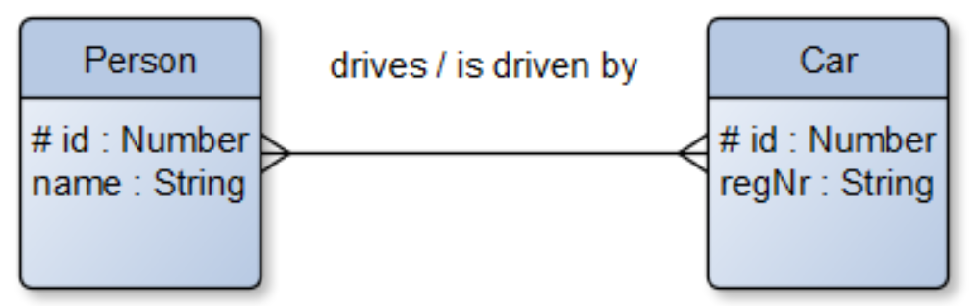
Architecture doc styles – modules styles
data model levels
logical
choose data storage type – document, key-value, relational, etc
describe the stored data structures
define operations for the stored data structures

Slide 43
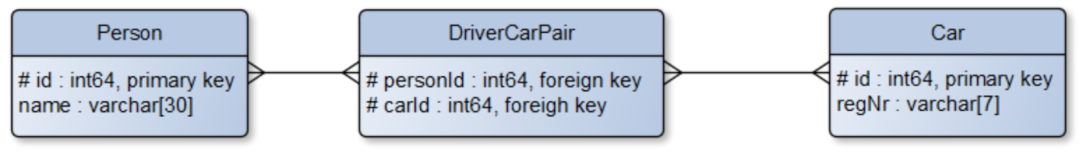
Architecture doc styles – modules styles
data model levels
physical
adopt for a concrete DB implementation
guide optimizations
generate DB code

Slide 44
Architecture doc styles – component-n-connectors styles
component-n-connector styles
focus on viewing the system as a set of
runtime units – components
data stores
interaction mechanism between the above – connectors
are used to
explain how the system works at runtime
address main quality attributes

Slide 45
Architecture doc styles – component-n-connectors styles
component-n-connector style categories
call-return styles
data flow styles
event-based styles
repository styles

Slide 46
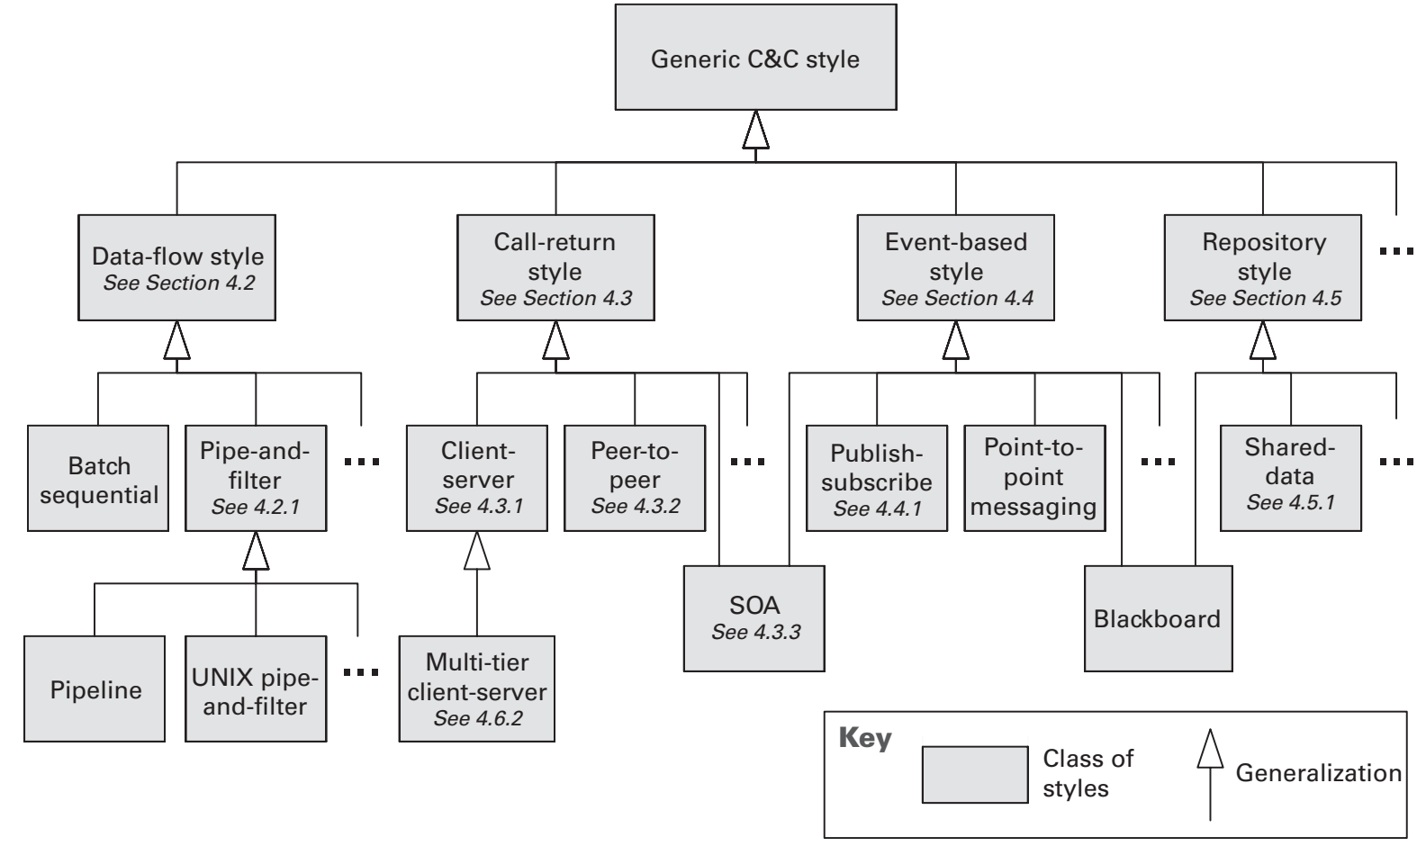
Architecture doc styles – component-n-connectors styles
component-n-connector styles

Slide 47
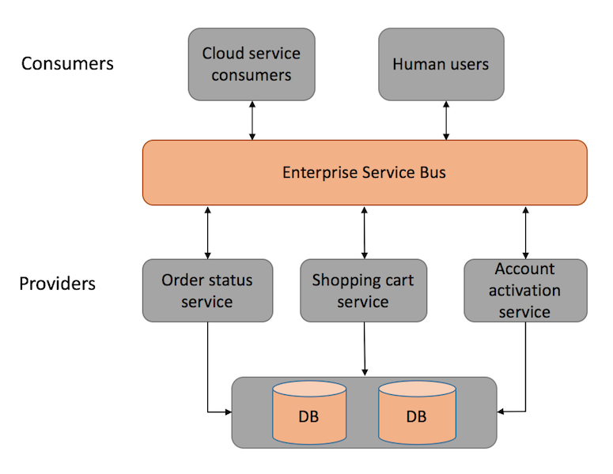
Architecture doc styles – component-n-connectors styles
for example, for the soa style
components are service consumers, service providers, and infrastructure providers
connectors are request-response or asynchronous messages
properties addressed are performance scaling, reliability, availability, fault-tolerance, and cost

Slide 48
Architecture doc styles – allocation styles
focus on the resources consumed by the project
deployment style > real hardware
install style > files used during deployment
work assignment style > teams responsible for concrete modules

Slide 49
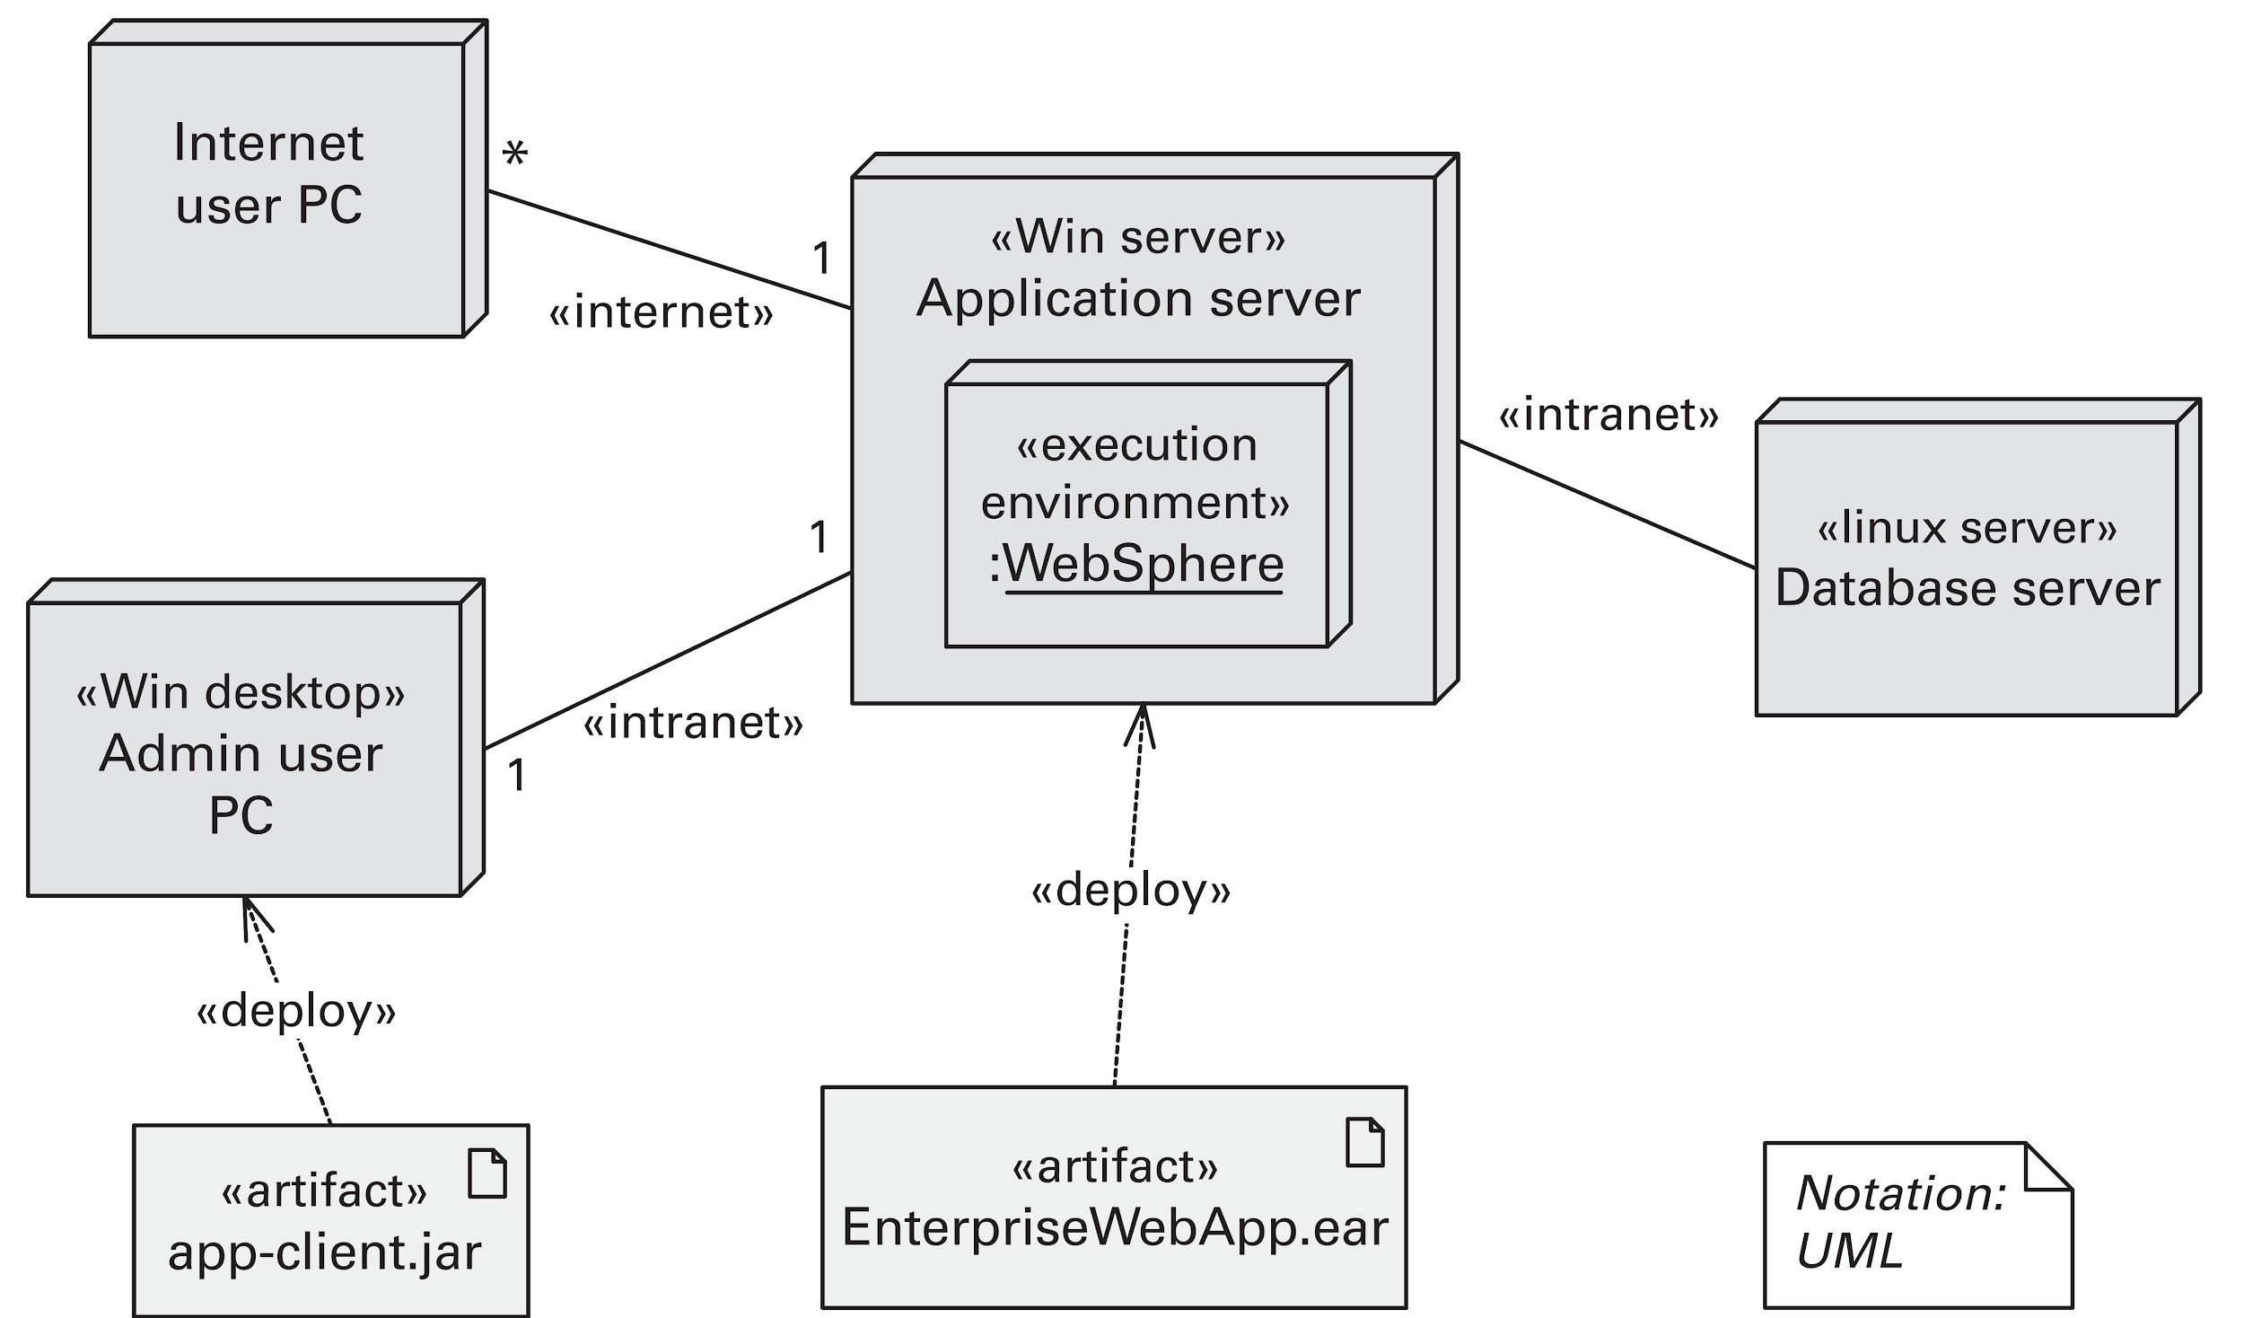
Architecture doc styles – allocation styles
most used – deployment style

Slide 50

50

